Slide 1




Fairness in Ranking in Information Access Systems
Amifa Raj Michael Ekstrand Ph.D. (Advisor)
Sole Pera, Ph.D. Edoardo Serra, Ph.D.
Casey Kennington, PhD
Grant No. IIS 17-51278

Slide 2









Slide 3
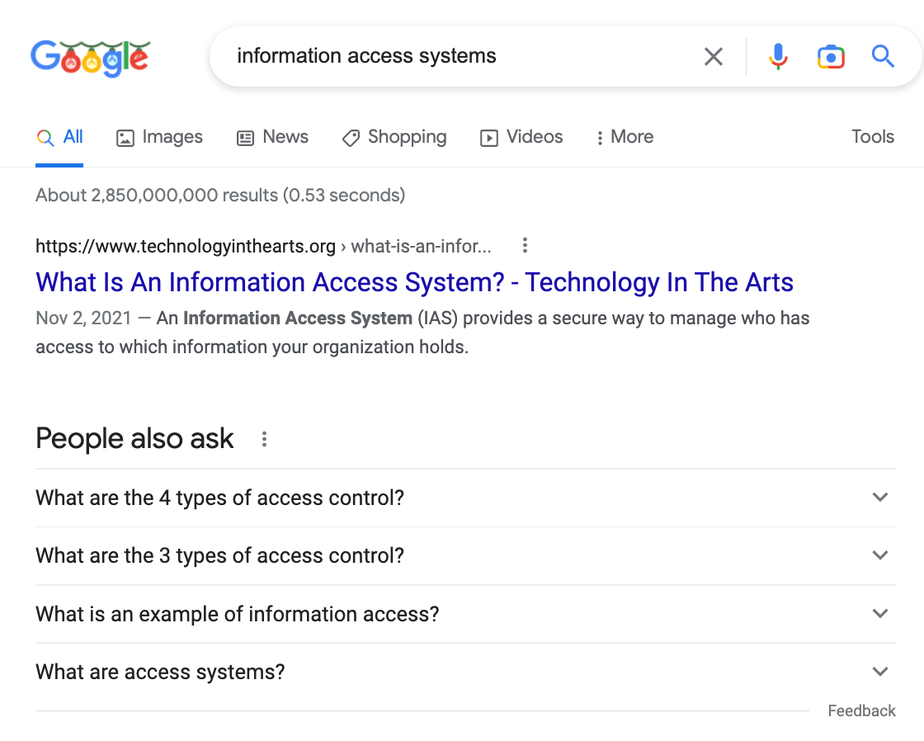




query

Slide 4
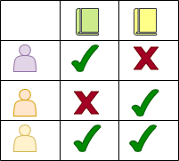
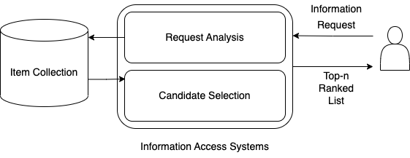











Information Access Systems (IAS) Framework
Consumer
query
Provider
Consumer

Slide 5

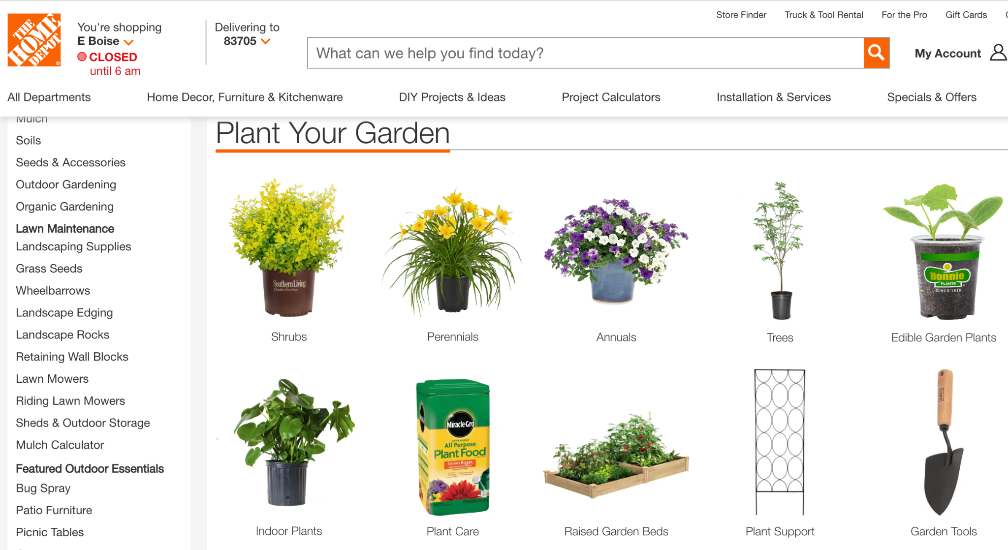


Slide 6



Images are from https://www.freepik.com/

Slide 7
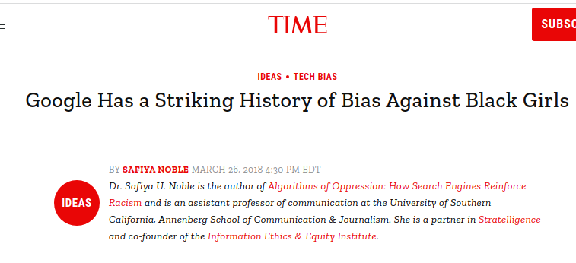



Notes:
Matching relevance or utility is not the only issue regarding IAS. fairness is an ongoing concern

Slide 8


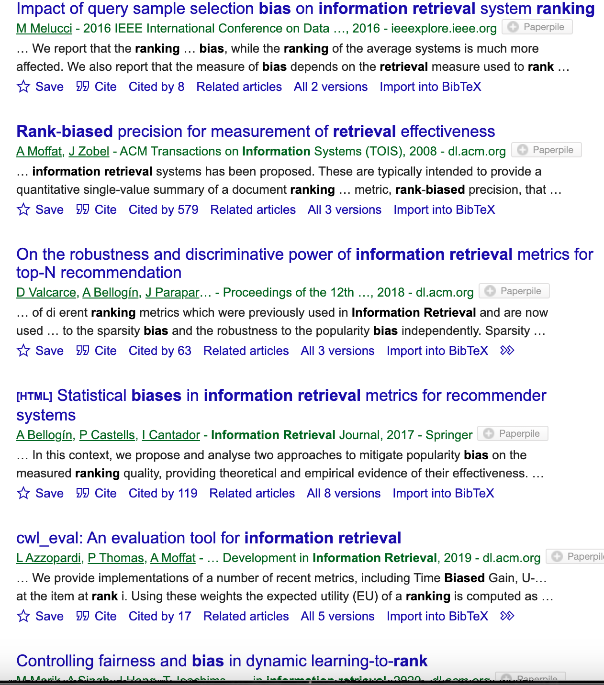
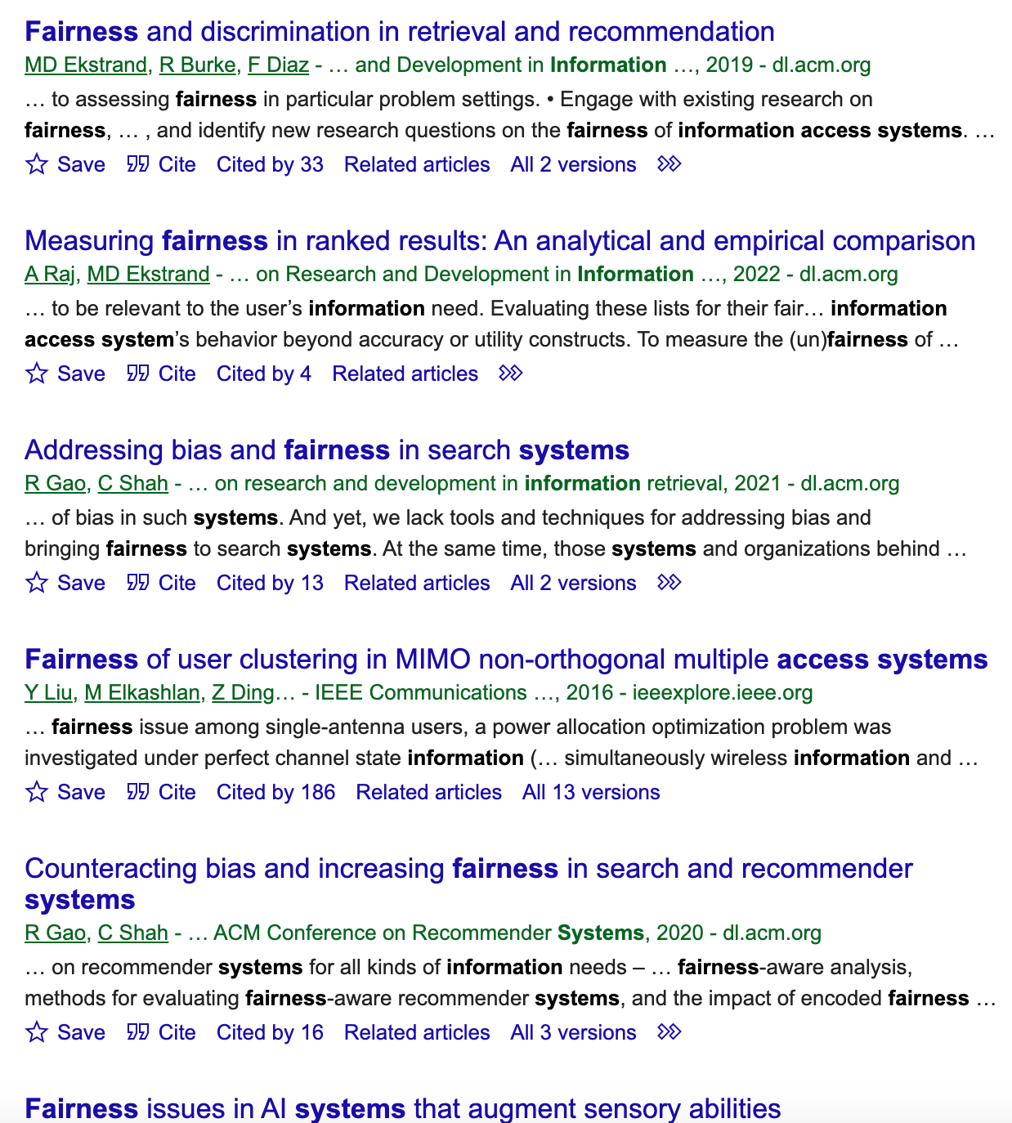

Slide 9
Key Concepts
Bias/ Unfairness
Exposure/Attention
Group-fairness
Sensitive Attributes
Optimization
Re-ranking

Slide 10
Bias
Difficult to define
Domain dependent
Systematic and unfair discrimination against certain individual or group entities by denying opportunity and assigning unfair outcomes
Group (Sensitive Attributes) and Individual Fairness
B. Friedman and H. Nissenbaum. Bias in computer systems. ACM Transactions on Information Systems (TOIS), 14(3):330–347, 1996

Slide 11
Biased Representation
Biased Allocation/Distribution
Notes:
What kind of bias I am focusing on and why it is relevant and important and enough details to follow

Slide 12




Position
1
User Request
2
3
4
Exposure
5
6
Attention
Ranked Items
Providers
Consumer
Notes:
Items receives disparate exposure based on position

Slide 13


Disparate Exposure
1
2
3
Attention
4
5
6
Ranked List

Slide 14
Fairness Positioning
Geography
Age
Race
Gender
Economic status
Sensitive Attributes
Provider Fairness
Group Fairness

Slide 15



Fairness Concern
Re-ranking
Is this ranking fair for provider groups?
Measure Fairness
Fairness Optimization

Slide 16
Fairness Concern
Measurement and optimization of provider-side group fairness in ranking of information access systems (IAS)

Slide 17
Research Objectives
01
02
03
Analyzing Fair Ranking Metrics
Beyond Linear Layout Fairness
Optimize Grid-Based Layout
Provide comprehensive and comparative analysis of fair ranking metrics research
Contribute to the advancement of fair ranking metrics
Contribute to the improvement of provider-side group fairness in IAS ranking

Slide 18
Research Components
Completed
In-Progress
To-Do
Component 1
Analyzing Fair Ranking Metrics
Component 2
Beyond Linear Layout Fairness
Component 3
Optimize Grid-Based Ranking
Task 1 Conceptual Analysis of Fair Ranking Metrics
Task 1 Modify Fair Ranking Metrics for
Other Layout Models
Task 1 Design Fairness-Aware Re-ranking Techniques for Grid-based Layouts
Task 2 Conceptual Analysis of Fair Ranking Metrics
Task 2 Implement Fair Ranking Metrics in other Layout Models using Real-World Dataset
Task 2 Optimize Grid-based Layout for both Column Reduction Approaches
Task 3 Sensitivity Analysis
Task 3 Analyze Metric Scores Across Layout Models
Task 3 Optimize Grid-based Layout for both Column Reduction Approaches
Task 4 Simulation study
Task 4 Analyze Metric Scores Across Column Reduction Approaches

Slide 19

Components
Component 1
Component 2
Component 3
Is this ranking fair for provider groups?
Component 1
Analyzing Fair Ranking Metrics

Slide 20
Analyzing Fair Ranking Metrics
Components
Component 1
Component 2
Component 3
PreF𝚫 (Yang et. al.; SSDBM ‘17):
AWRF (Sapienzynski et. al.; WWW’19)
EEL, EED, EER Diaz et.al.; CIKM’20)
FAIR (Zehlike et.al.; CIKM’17)
IAA (Biega et. al.; SIGIR’18)
DP, EUR, RUR (Singh et.al.; KDD’18)

Slide 21


Motivation
Components
Component 1
Component 2
Component 3
Several Fair Ranking Metrics
No Comparative and Comprehensive Analysis

Slide 22




Why is the Problem a Problem?
Components
Component 1
Component 2
Component 3
Finding Suitable Metrics
Differences among the Metrics
Implementation in Real-world IAS dataset

Slide 23
Research Questions
Components
Component 1
Component 2
Component 3
RQ1. What are the conceptual differences among the fair ranking metrics?
RQ2. What is needed to apply these metrics to real IAS?
RQ3. What are the design decisions and parameters involved, and how sensitive are the resulting metrics to those decisions?
RQ4. What are the empirical differences in how these metrics assess the relative fairness of different recommendation algorithms or retrieval runs?

Slide 24
Research Tasks
Components
Component 1
Component 2
Component 3
Conceptual Analysis of Fair Ranking Metrics
Implementing Fair Ranking Metrics in Real-World IAS Datasets
Sensitivity Analysis

Slide 25
Metrics Design Decomposition
Components
Component 1
Task 1
Component 2
Task 2
Component 3
Task 3
Task 4
Fairness Goal
What does it mean to be fair?
attention

Slide 26
Fairness Goal
Components
Component 1
Task 1
Component 2
Task 2
Component 3
Task 3
Task 4
Relevance
Exposure/Attention
PreF𝚫, FAIR, AWRF, DP, EED
IAA, EUR, RUR, EEL, EER
Group A
Item position should not be affected by membership
Exposure/attention should be proportional to relevance
Statistical Parity
Equal Opportunity
Group B

Slide 27
Metrics Design Decomposition
Components
Component 1
Task 1
Component 2
Task 2
Component 3
Task 3
Task 4
Fairness Goal
Browsing Model
What does it mean to be fair?
How to measure position weight?
attention

Slide 28
Browsing Models
Components
Component 1
Task 1
Component 2
Task 2
Component 3
Task 3
Task 4
visiting probability exponentially decreases with position
RBP
visiting probability exponentially decreases with position
Geometric
patience parameter
stopping probability
visiting probability depends on relevance of visited items
Cascade
visiting probability logarithmically decreases with position
Logarithmic
patience parameter
stopping probability

Slide 29
Metrics Design Decomposition
Components
Component 1
Task 1
Component 2
Task 2
Component 3
Task 3
Task 4
Fairness Goal
Browsing Model
What does it mean to be fair?
How to measure position weight?
Target Exposure
attention
Compare system exposure with what?

Slide 30
Target Exposure
Population estimator
From full ranking
Configured
Binomial
Ideal exposure based on relevance
Estimated utility (Predicted relevance)

Slide 31
Metrics Design Decomposition
Components
Component 1
Task 1
Component 2
Task 2
Component 3
Task 3
Task 4
Fairness Goal
Browsing Model
What does it mean to be fair?
How to measure position weight?
Target Exposure
Relevance
attention
Compare system exposure with what?
How to incorporate relevance?
Group Membership
Does it allow multinomial and soft group association?

Slide 32
Group Membership
Components
Component 1
Task 1
Component 2
Task 2
Component 3
Task 3
Task 4
Multinomial Protected Attributes
Non-Binary Groups, such as gender
Soft Group Association
Partial or mixed group membership such as race

Slide 33
Statistical Parity
Components
Component 1
Task 1
Component 2
Task 2
Component 3
Task 3
Task 4
Exposure/Attention
AWRF (Sapienzynski et. al, WWW’19)
⋀
Expected cumulative exposure( Group B x position weight) >=p
Target distribution is the group distribution in entire ranked list (true demographics)
Group A
no relevance information
geometric attention decay
non-binary group membership
uses a target distribution to compare
PreF𝚫 (Yang et. al, SSDBM’17) and FAIR (Zehlike et. al, CIKM’17) do not use position weight and do not allow multinomial group membership.
Group B

Slide 34
Sequences of Ranking
Components
Component 1
Task 1
Component 2
Task 2
Component 3
Task 3
Task 4
Statistical Parity (Multiple Rankings)
DP, EED
Equal Opportunity
All the metrics
…

Slide 35
Equal Opportunity
Components
Component 1
Task 1
Component 2
Task 2
Component 3
Task 3
Task 4
EE* (Diaz et. al, CIKM’20)
Relevance
Exposure/Attention
EEL(Expected Exposure Loss): ||target-system||2
EER (Expected Exposure Relevance): Exposure-relevance distribution
stochastic ranking
rbp & cascade attention decay
non-binary group membership
IAA (Biega et. al, SIGIR’18) differs in weighting strategy, group membership, and relevance
EUR, RUR (Singh et. al, SIGKDD’18) differs in weighting strategy and group membership

Slide 36

Findings
Components
Component 1
Task 1
Component 2
Task 2
Component 3
Task 3
Task 4
Task 1: Conceptual Analysis Fair Ranking Metrics
Metrics are conceptually similar with common components like relevance, browsing model, aggregation, target exposure
Metrics differs in their design choices and fairness assumption
Metrics with same goal can have different design choices

Slide 37
Metric Implementation
Components
Component 1
Task 1
Component 2
Task 2
Component 3
Task 3
Task 4
 | Recommendations | Search (retrieval and re-ranking)
Dataset | GoodReads bookdata | FairTREC 2020
Sensitive Attributes | Gender of author | Economic development of the author’s country of scholarly articles
Algorithms | CF (implicit feedback) | Participants provided

Slide 38





Challenges in Implementation
Components
Component 1
Task 1
Component 2
Task 2
Component 3
Task 3
Task 4
IAA, EE*, DP, EUR, RUR
AWRF, IAA, DP, EUR, RUR, EE*
Missing Relevance Information
All the metrics
Parameter Setting
Missing Group Label
PreF𝚫, FAIR, IAA, DP, EUR, RUR
PreF𝚫 and RUR: suffer from missing data (sparsity) problem
Reformulated ratio-based metric to smoothed log ratio
Soft Group Association
Non-binary groups
Extreme Imbalance

Slide 39
Findings
Components
Component 1
Task 1
Component 2
Task 2
Component 3
Task 3
Task 4
Task 1: Conceptual Analysis of Fair Ranking Metrics
Metrics are conceptually similar with common components like relevance, browsing model, aggregation, target exposure
Metrics differs in their design choices and fairness assumption
Metrics with same goal can have different design choices
Task 2: Implementing Fair Ranking Metrics in Real-World Datasets
Missing data, missing relevance information, ranked list size are crucial/delicate factors in implementing metrics.
Metrics with similar fairness goals differ in their ease of implementations

Slide 40
Sensitivity Analysis
Components
Component 1
Task 1
Component 2
Task 2
Component 3
Task 3
Task 4
Ranked-list size
Weighting
Strategy
Stopping Probability
Patience Parameter
No effect on metrics for FairTREC
Ratio-based metrics and FAIR showed sensitivity
Default parameters
EEL and logRUR showed high sensitivity
Almost all metrics showed sensitivity
logRUR is extremely sensitive
logRUR showed high sensitivity

Slide 41
Sensitivity Analysis
Components
Component 1
Task 1
Component 2
Task 2
Component 3
Task 3
Task 4
Task 1: Conceptual Analysis of Fair Ranking Metrics
Metrics are conceptually similar with common components like relevance, browsing model, aggregation, target exposure
Metrics differs in their design choices and fairness assumption
Metrics with same goal can have different design choices
Task 2: Implementing Fair Ranking Metrics in Real-World Datasets
Missing data, missing relevance information, ranked list size are crucial/delicate factors in implementing metrics.
Metrics with similar fairness goals differ in their ease of implementations
Task 3: Sensitivity Analysis
Metrics differ in their sensitivity towards external factors.
High sensitivity towards design choices add complexity in the usability of metrics

Slide 42

Metric Recommendations
Components
Component 1
Task 1
Component 2
Task 2
Component 3
Task 3
Task 4
Allow multinomial protected attributes | Allow soft group association | Sensitivity towards design choices
AWRF | AWRF | AWRF
EED | EED | EED
EER, EEL | EER, EEL | EER, EEL, IAA
Single-list metrics
FAIR, AWRF
Demographic Parity in Sequence
DP, EED
Equal Opportunity in Sequence
EUR, RUR, IAA, EER, EEL

Slide 43

Contribution
Components
Component 1
Task 1
Component 2
Task 2
Component 3
Task 3
Task 4
01
02
Describe and compare rank-fairness metrics in unified framework
Identify gaps between their original presentation and the practicalities of applying them to IAS
03
04
Direct comparison of their outcomes with same data and experimental setting
Sensitivity analysis to assess the impact of design choices and external factors on these metrics

Slide 44
Components
Current Stage
Component 1
Task 1
Component 2
Task 2
Component 3
Task 3
Task 4
2020
Simulation Study
Better understand the impact of design factors like
relevance-set size
group distribution, and
missing relevance information
on metric implementation and outputs
Raj, A., Wood, C., Montoly, A., & Ekstrand, M. D. (2020). Comparing fair ranking metrics. 3rd FAccTRec Workshop at RecSys 2020
arXiv:2009.01311
2022
Raj, A., & Ekstrand, M. D. (2022, July). Measuring Fairness in Ranked Results: An Analytical and Empirical Comparison. In Proceedings of the 45th International ACM SIGIR Conference on
DOI 10.1145/3477495.3532018

Slide 45

Components
Component 1
Component 2
Component 3
Component 2
Beyond Linear Layout Fairness
Is this ranking fair for provider groups in grid-based layout?

Slide 46



Components
Component 1
Component 2
Component 3

Slide 47


Layout Models
Components
Component 1
Component 2
Component 3
Linear Layout Model
Grid Layout Model
Multi-List
Wrapped
Vertical
Horizontal

Slide 48
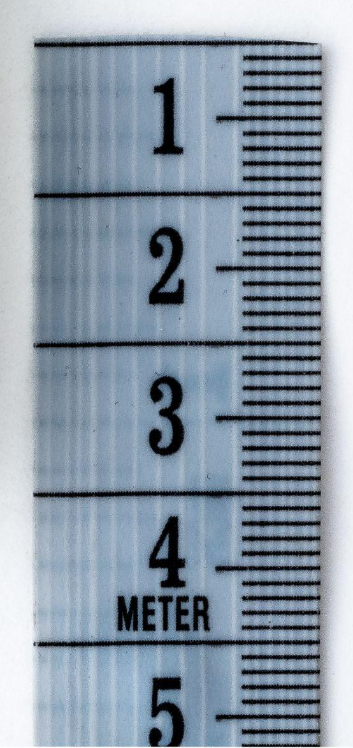


Motivation
Components
Component 1
Component 2
Component 3
GRID LAYOUTS… GRID LAYOUTS
EVERYWHERE
Metrics Only Suitable for Linear Layout
Common Use of Various Layout Models
Lack of Previous Research
Image by rawpixel.com on Freepik

Slide 49




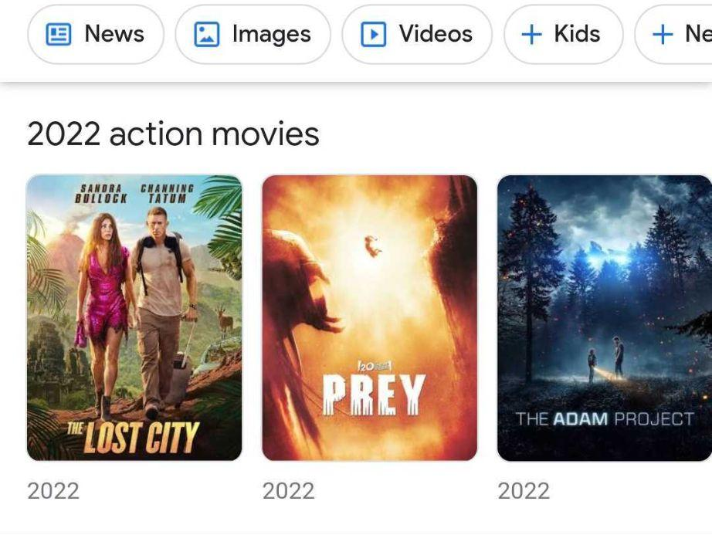
Why is the Problem a Problem?
Components
Component 1
Component 2
Component 3
？
？
✔
Metric Applicability?
Fairness Score Consistency Across Layout Models?
Fairness Score Consistency Within Layout Model?

Slide 50
Research Questions
Components
Component 1
Component 2
Component 3
RQ1. Does the fair ranking metric score remain consistent across layout models?
RQ2. Does a group fairness-aware ranked list remain fair across layout model?
RQ3. Does the group fairness score for providers change with the reduction of ranking size within a grid-based ranking?
RQ3.a. Does the fair ranking metric score change when the grid-based list is truncated?
RQ3.b. Does the fair ranking metric score change when the grid-based list is re-wrapped?
RQ3.c. Does the change in group-fairness score with column size reduction remain con-
sistent across truncation and re-wrap approach?.

Slide 51
Research Tasks
Components
Component 1
Component 2
Component 3
Modify Fair Ranking Metrics for
Other Layout Models
Implement Fair Ranking Metrics in other Layout Models using Real-World Dataset
Analyze Metric Scores Across Layout Models
Analyze Metric Scores Across Column Reduction Approaches

Slide 52
User Attention
Components
Component 1
Component 2
Task 1
Component 3
Task 2
Task 3
Task 4
Probability of row skipping
 | c1 | c2 | c3
r1
r2
r3
r4
 | c1 | c2 | c3
r1
r2
r3
r4
 | c1 | c2 | c3
r1
r2
r3
r4
r1 r2 r3 r4
F-shaped
Central-Fixation
Middle-Bias
Row-Skipping
c1 | c2 | c3 | c4
Figures are inspired by Xiaohui Xie, Jiaxin Mao, Yiqun Liu, Maarten de Rijke, Yunqiu Shao, Zixin Ye, Min Zhang, and Shaoping Ma. 2019. Grid-based Evaluation Metrics for Web Image Search. (2019).
Slower-Decay

Slide 53
Expected Findings
Components
Component 1
Component 2
Task 1
Component 3
Task 2
Task 3
Task 4
Task 1: Modify Fair Ranking Metrics for Various Layout Models
Find layout-suitable user browsing models
Find how to modify user-browsing models for layout suitable user attention behavior

Slide 54
Metric Implementation
Components
Component 1
Component 2
Task 1
Component 3
Task 2
Task 3
Task 4
Dataset | Recommendations: GoodReads bookdata Search: Fair Ranking Track (TREC)
Metrics | Demographic Parity: AWRF Equal-Opportunity: Expected-Exposure Family Metrics
Browsing Models | Linear: Cascade, Geometric, Logarithmic Grid: Modified for slower-decay, row-skipping, and middle-bias

Slide 55
Expected Findings
Components
Components
Component 1
Component 1
Component 2
Component 2
Task 1
Task 1
Task 2
Component 3
Task 2
Component 3
Task 3
Task 3
Task 4
Task 4
Task 1: Modify Fair Ranking Metrics for Various Layout Models
Find suitable layout-suitable user browsing models
Find how to modify user-browsing models for layout suitable user attention behavior
Task 2: Implementing Fair Ranking Metrics in
Find the requirements to implement metrics in various layout models

Slide 56
Analyzing Metric Scores across
Layout Models
Components
Component 1
Component 2
Task 1
Component 3
Task 2
Task 3
Task 4
Given a set of ranked items
Measure fairness of the ranking in linear list
Measure fairness of the ranking in grid-view
Compare the fairness scores
Given a set of ranked items
Optimize the linear ranking for fairness
Measure fairness of the optimized ranking in grid-view
Compare the fairness scores
Fairness Score Consistency
Is it Still Fair?

Slide 57
Expected Findings
Components
Component 1
Component 2
Task 1
Component 3
Task 2
Task 3
Task 4
Task 1: Modify Fair Ranking Metrics for Various Layout Models
Find suitable layout-suitable user browsing models
Find how to modify user-browsing models for layout suitable user attention behavior
Task 2: Implementing Fair Ranking Metrics in
Find the requirements to implement metrics in various layout models
Task 3: Analyze Metric Scores Across Layout Models
Find the persistence of fairness score across layout models
Find how user attention and group distribution changes across layout models
Find if the ranking remains fair with the change of layout models

Slide 58


Analyzing Metric Scores within Grid-View
Components
Component 1
Component 2
Task 1
Component 3
Task 2
Task 3
Task 4
truncated
Given a set of ranked items
Measure fairness of the ranking changing column size using both truncate and re-wrapped approach
Measure fairness
Compare the fairness scores across column reduction approaches
Fairness Score Consistency
re-wrapped

Slide 59
Expected Findings
Components
Component 1
Component 2
Task 1
Component 3
Task 2
Task 3
Task 4
Task 1: Modify Fair Ranking Metrics for Various Layout Models
Find suitable layout-suitable user browsing models
Find how to modify user-browsing models for layout suitable user attention behavior
Task 2: Implementing Fair Ranking Metrics in
Find the requirements to implement metrics in various layout models
Task 3: Analyze Metric Scores Across Layout Models
Find the persistence of fairness score across layout models
Find how user attention and group distribution changes across layout models
Find if the ranking remains fair with the change of layout models
Task 4: Analyze Metric Scores Across Column-Reduction Approaches
Find the impact of column size on metrics scores
Find how group distribution changes with reduction approaches
Find the impact of reduction approaches on provider-side group fairness scores

Slide 60
Contribution
Components
Component 1
Component 2
Task 1
Component 3
Task 2
Task 3
Task 4
01
02
Provide types of ranking layout models that are often used to display search results and recommended items.
Provide modified fair ranking metrics which incorporate suitable browsing models to measure fairness in a given layout model.
03
04
Provide insights on fairness score consistency and applicability across layout models.
Provide insights on the impact of column reduction approaches on fairness score within a grid-based ranking.

Slide 61

Components
Component 1
Component 2
Component 3
Component 3
Optimize Grid-Based Layout
How to optimize this ranking for group-fairness?

Slide 62

Motivation
Components
Component 1
Component 2
Component 3
GRID LAYOUTS… GRID LAYOUTS
EVERYWHERE
Common Use of Various Layout Models
Re-ranking Techniques Only Suitable for Linear Layout
Lack of Previous Research

Slide 63
Why is the Problem a Problem?
Components
Component 1
Component 2
Component 3
Fairness can vary across devices (column size)
Fairness can vary column-reduction approaches

Slide 64
Research Questions
Components
Component 1
Component 2
Component 3
RQ1. How can we design fairness aware re-ranking techniques for grid-based layouts?
RQ2. How can we optimize grid-based ranking layout for group fairness in IAS when the size of column is being reduced?
RQ2.a. How can we optimize truncated grid-based layout for group fairness ?
RQ2.b. How can we optimize re-wrapped grid-based layout for group fairness?
RQ2.c. How can we optimize grid-based layout simultaneously for various screen sizes?

Slide 65
Research Tasks
Components
Component 1
Component 2
Component 3
Design Fairness-Aware Re-ranking Techniques for Grid-based Layouts
Optimize Grid-based Layout for both Column Reduction Approaches
Optimize Grid-based Layout Simultaneously for Screen Sizes

Slide 66
Fairness-Aware Re-ranking
Techniques for Grid-based Layouts
Components
Component 1
Component 2
Component 3
Task 1
Task 2
Task 3
Component 2 will provide an insight on group exposure distribution in grid-based ranking
Design a simple and preliminary re-ranking technique to optimize grid-based ranking for provider-side group fairness
Design the technique as reusable for more suitable user attention models

Slide 67
Optimize Grid-based Layout for both Column Reduction Approaches
Components
Component 1
Component 2
Component 3
Task 1
Task 2
Task 3
Component 2 will show how group fairness score changes across column-reduction approaches.
Design group fairness-aware re-ranking technique for truncated grid-based ranking
Design group fairness-aware re-ranking technique for re-wrapped grid-based ranking

Slide 68
Optimize Grid-based Layout Simultaneously for Screen Sizes
Components
Component 1
Component 2
Component 3
Task 1
Task 2
Task 3
Component 2 will show how group fairness score changes across column size.
Design group fairness-aware re-ranking technique that will optimize grid-based ranking when device is uncertain

Slide 69

Expected Contribution
Components
Component 1
Component 2
Component 3
Task 1
Task 2
Task 3
01
02
Provide preliminary and reusable re-ranking techniques for grid-based ranking
Provide insights on fairness optimization when device is uncertain
03
Provide insights on fairness optimization suitable for column reduction approaches

Slide 70
Publications and Target
Fairness in Ranking in Information Access Systems
Gender Stereotypes in IAS
Analyzing Fair Ranking Metrics
A. Raj, A. Milton, and M. D. Ekstrand. Pink for princesses, blue for superheroes: The need to examine gender stereotypes in kid’s products in search and recommendations. (IDC KidRec 2021)
A. Raj, C. Wood, A. Montoly, and M. D. Ekstrand. Comparing fair ranking metrics (FAccTRec 2020)
A. Raj and M. D. Ekstrand.Measuring Fairness in Ranked Results: An Analytical and Empirical comparison. (SIGIR 2022)
Simulation Study
A. Raj and M. D. Ekstrand. Fire dragon and unicorn princess; gender stereotypes and children’s products in search engine responses. (SIGIR eCom 2022)
Targeting TOIS 2023 (March))
Beyond Linear Ranking Fairness
Targeting SIGIR 2023 (January 31st)
Fairness-Aware Grid-Based Ranking
Targeting RecSys 2023 (May)

Slide 71
 | 2018 |  | 2019 |  |  | 2020 |  |  | 2021 |  |  | 2022 |  | 2023
 | Fall | Spr. | Sum. | Fall | Spr. | Sum. | Fall | Spr. | Sum. | Fall | Spr. | Sum. | Fall | Spr. | Sum.
Coursework
Component 1
Comprehensive Exam
Research Publication
Internship (Microsoft)
Proposal Defense
Component 2
Component 3
Final Defense

Slide 72
Thank you

Slide 73
High-Level Research Question
How to improve fairness in ranking of information access systems (IAS)?

